Slide 1

"His Hawaiian Excellency"
Personal Impressions after Reading the Book (in Russian translation) and Key Findings on History of Annexation of the Hawaiian Kingdom
Ekaterina Vasiltsova, Student of MA Program International Security

Slide 2
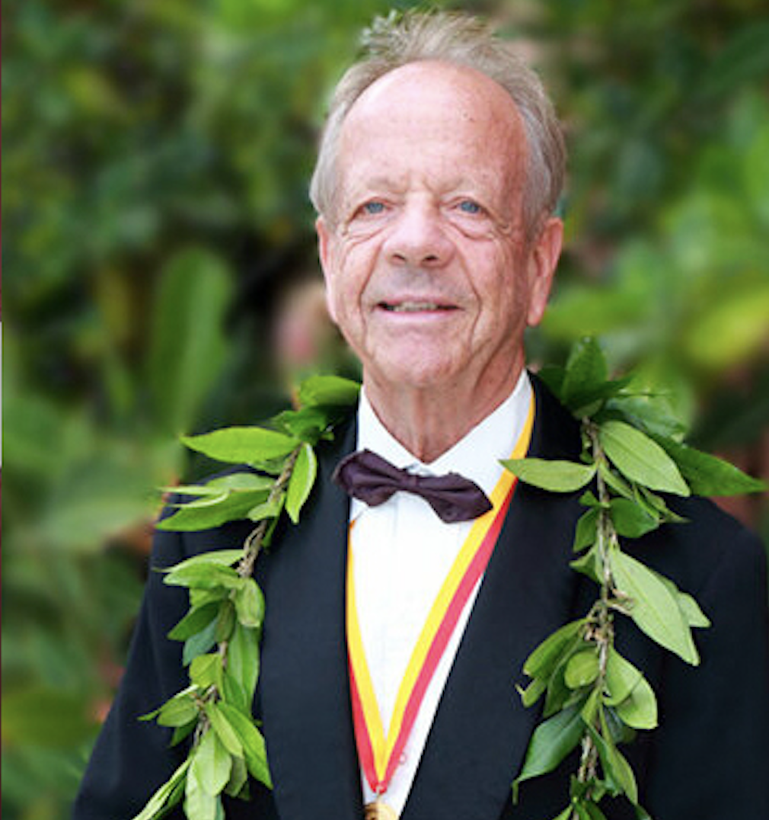
About the Author
Niklaus Schweizer
Swiss historian, honorary consul of Switzerland in Hawaii, and member of the Royal Order of Kamehameha - the highest honor a foreigner can receive from the Hawaiian Kingdom.

Slide 3
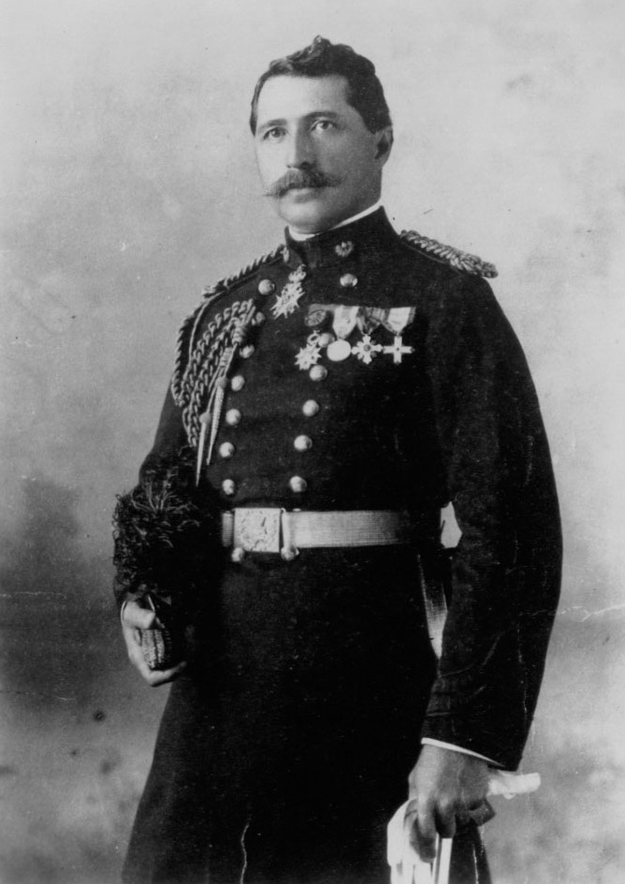
The Narrator at the Center
Colonel Curtis Piʻehu Iʻaukea
A real historical figure - court official and diplomat of the Hawaiian Kingdom. The novel follows his service to King Kalakaua and Queen Liliuokalani.
"Very honest as a character — he rejoices when he should rejoice, and condemns his own shortcomings without avoiding the names of those who played a key role in the coup."
— Goodreads reviewer

Slide 4
Annexation as a Slow Process
Economic Dependence
Legal Erosion
Military Pressure
Economic dependence on American sugar planters weakened Hawaiian sovereignty.
The 1887 ”Bayonet” Constitution forcibly stripped the monarchy of power.
Queen Liliʻuokalani was overthrown in 1893 with U.S. military support. Annexation in 1898 simply formalized an existing reality.
The islands "became victims of their geographical position." The island
—Niklaus Schweizer

Slide 5
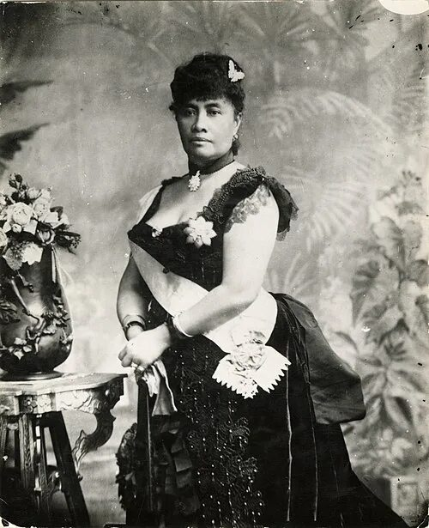
Queen Liliʻuokalani - Last Monarch of Hawaii
Schweizer's Observation
Reigned: 1891–1893
Tried to restore royal authority and protect native Hawaiians
Attempted to introduce a new constitution
Overthrown in 1893 by local conspirators backed by U.S. troops (USS Boston)
The book portrays her as dignified, determined, and honourable – not a passive victim
The islands "became victims of their geographical position." Formal annexation in 1898 — during the Spanish-American War and America's Pacific expansion — simply confirmed what had already been decided in the economy, in law, and in everyday life.

Slide 6
Three Key Takeaways
Sovereignty Is Concrete
A Colonial Mechanism
Dignity, Not Passivity
It lives in language, in rituals, in which flag is raised at the palace — and it disappears in the same slow, tangible way. You can watch it leave the room.
Economic interests, legal changes, and military presence each appear "normal" alone. In combination, they form a mechanism a small state cannot dismantle from within.
Liliuokalani and Iaukea are not portrayed as helpless victims. They act responsibly and honourably within a space of choice that keeps shrinking — and that human dimension is the novel's most moving quality.

Slide 7
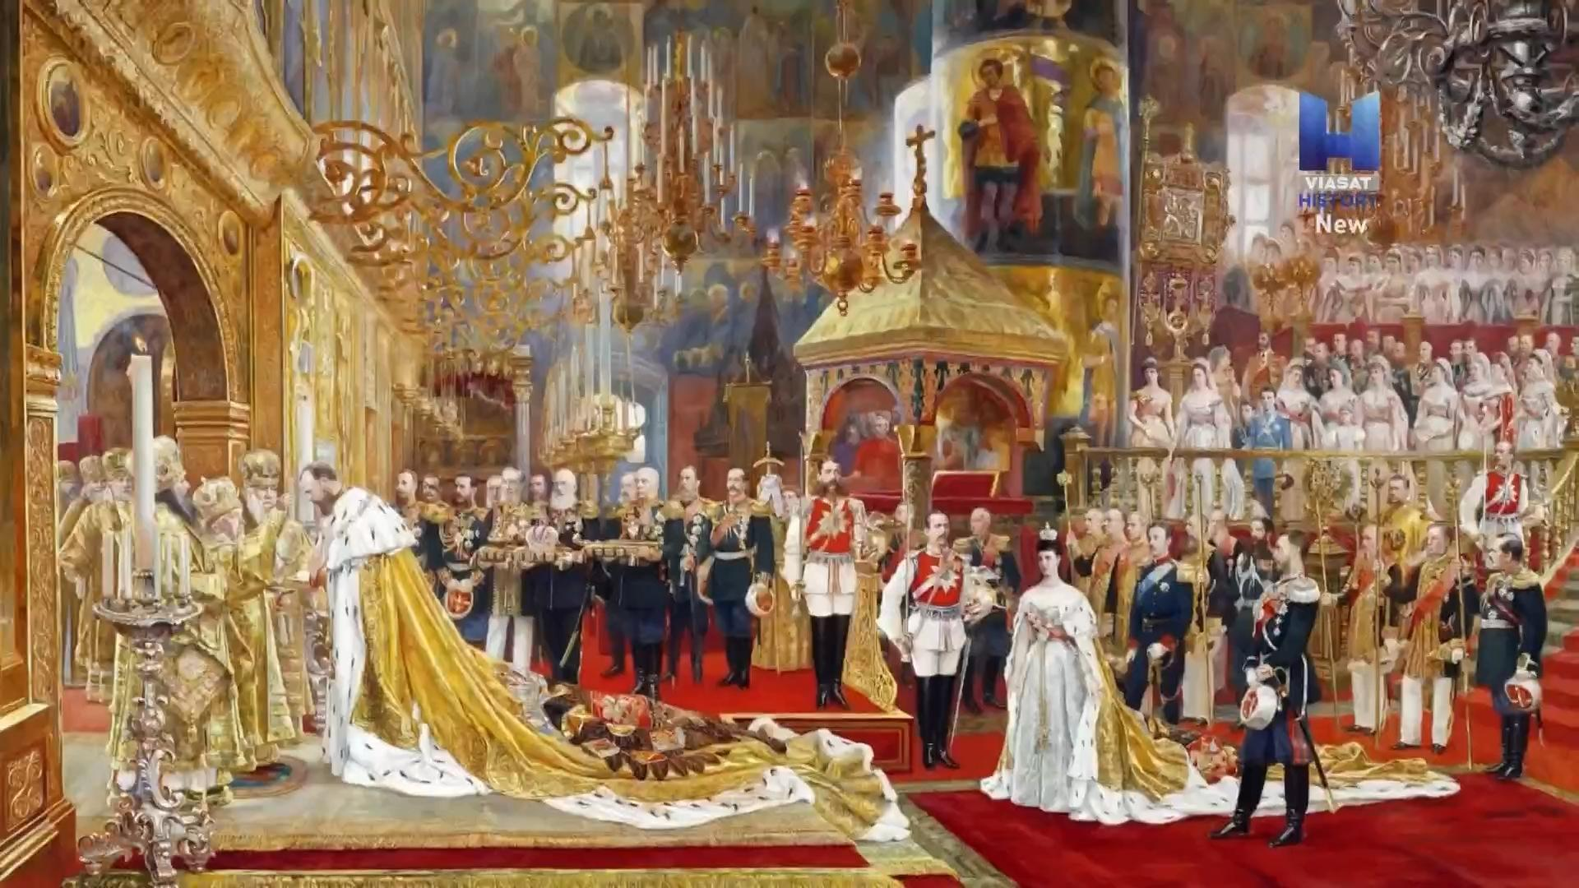
A Russian Dimension
An Unexpected Thread
Part of the novel's action unfolds in the Russian Empire. Iaukea attends the coronation of Alexander III in Moscow and receptions in St. Petersburg — a reminder of Hawaii's deep diplomatic reach.
On the island of Kauaʻi, forts still bear names like Fort Elizabeth, Fort Alexander, and Fort Barclay de Tolly — silent witnesses to an alternative history in which Hawaii might have become part of Russia.

Slide 8
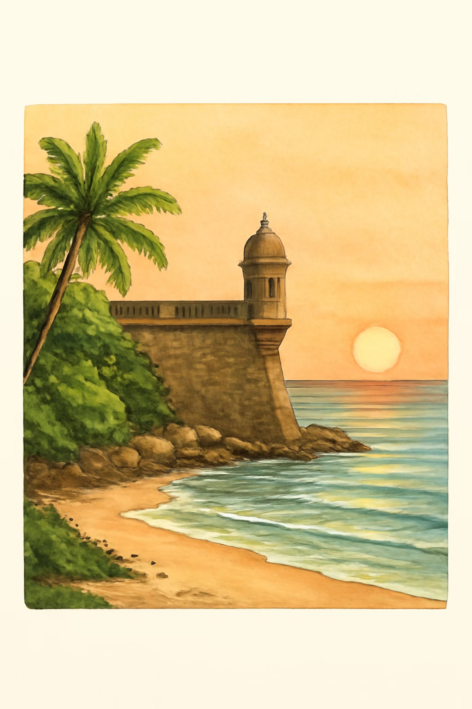
Why This Book Stays With You
"His Hawaiian Excellency" is not simply a historical novel about a distant past. It is a deeply human account of how people live through the loss of their country from the inside.
It is a warning about how easily small states lose control over their future when external interests and internal weaknesses converge — and how long that loss echoes in collective memory.

Slide 9
References
Schweizer, N. (2022). His Hawaiian Excellency: The Overthrow of Queen Liliʻuokalani’s Government and the Annexation of Hawaiʻi(«Его гавайское превосходительство»). Transl. from English by I. Ya. Kolotyrkina. Moscow: DeLibri.
Orlov, V. (2026). Hawaiʻi: Pages and Lessons of History, from https://www.orloff.world/copy-of-гавайи-страницы-и-уроки-истории
Schweizer's Observation
The islands "became victims of their geographical position." Formal annexation in 1898 — during the Spanish-American War and America's Pacific expansion — simply confirmed what had already been decided in the economy, in law, and in everyday life.

Slide 10
Thank you for your attention

